Slide 1
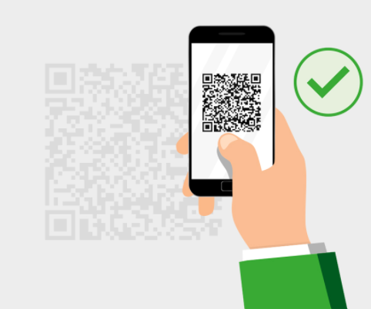
qr code in transports

Slide 2
team info
gehad Ahmed
Takwa Mohamed
Engy Esam
Aya abdelmoniem
Aya sheriff Mohamed
Khatab omar khatab

Slide 3

Introduction
The idea of applying QR code in transportation expresses the ease of using financial transactions, limiting the use of paper money and limiting the spread of infection by touching it. It is a safer and more widely used idea in developed countries.
The user will be registered through application on online basis.

Slide 4
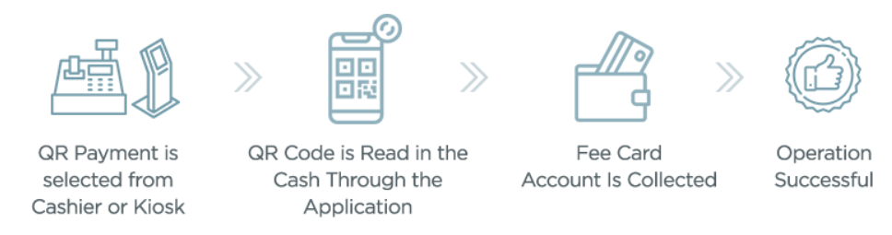
Abstract
In this app, after registration profile, we have to attach our bank details to this app and add money to the wallet. Whenever we go by bus, we have to select from and to location.
It Scans the QR code from the machine of the bus with a particular ID
Then we can scan QR code. So directly money will transfer from our wallet to transport corporation
Then we will get an SMS alert for ticket payment proof.

Slide 5
ERD
select from and to location
select the bus from list
enter num of pass
user
android app
enter login
enter bank details
money wallet
QR
scan
web sever database
money calculation
check bus machine id
send SMS

Slide 6
Advantage Disadvatage
Easy ticket process. system may be dropped
limiting theft of money the card may be stolen
The project would be valuable to general society
Limit the Viral infection and Promiscuity
The card will be available to everybody

Slide 7
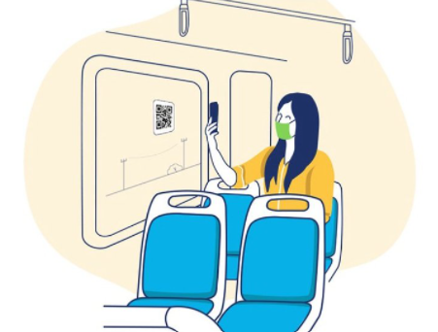
conclusion
framework would empower the general population to have the ticket for movement in metropolitan and for the most part open transport, in addition, the printed material will be decreased and loosing of the card is additionally wiped out elements of the ticket of each traveller are put away in the database alongside conductor points of interest which are followed by the administrator

